Slide 1
Data programming final project
submitted by: Group 6

Slide 2
Introduction to the project
Without Data Analysis, there can’t be any opinions in today’s world.
A similar approach was followed to demonstrate the data analysis and data visualisations, combined with data programming to display the insights on a website.
A dataset of Winter Olympics has been taken and analyzed. Then using Plotly in Python, the visualisations have been prepared and presented.
A brief discussion of the methods of analyzation, databases and visualizations will follow as we probe ahead.

Slide 3




The team
Sarthak Shah (Team Lead)
Prerna Saurabh Kohok – (Analyst)
Srishti Seth – (Developer)
Bikramjot Singh – (Developer)

Slide 4
Dataset description
The chosen dataset consists of the records of the Winter Olympics having a time range of 1924 to 2006.
The columns contain information regarding Year, City, Sport, Discipline, NOC, Event, Gender and the Medal won.
Total number of entries are 2897.
The source of the dataset is - http://winterolympicsmedals.com/athletes.csv

Slide 5
Project description
The project was coded using Jupyter Notebook.
We imported Pandas library to load the data and to analyze it.
A SQL database was constructed and used to store data analysis and the outputs.

Slide 6
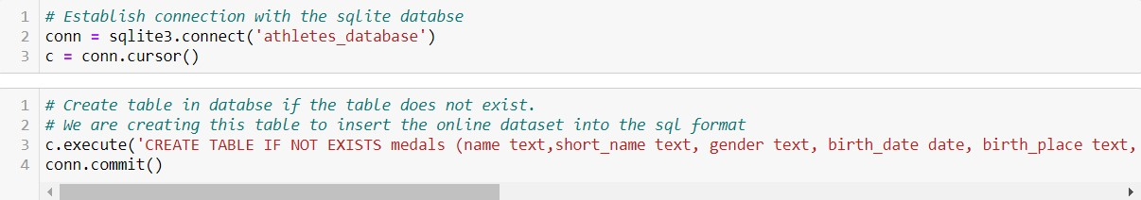
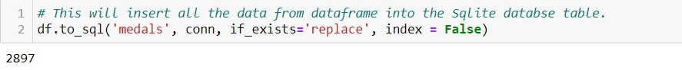
Construction of database and tables in sql.

Slide 7
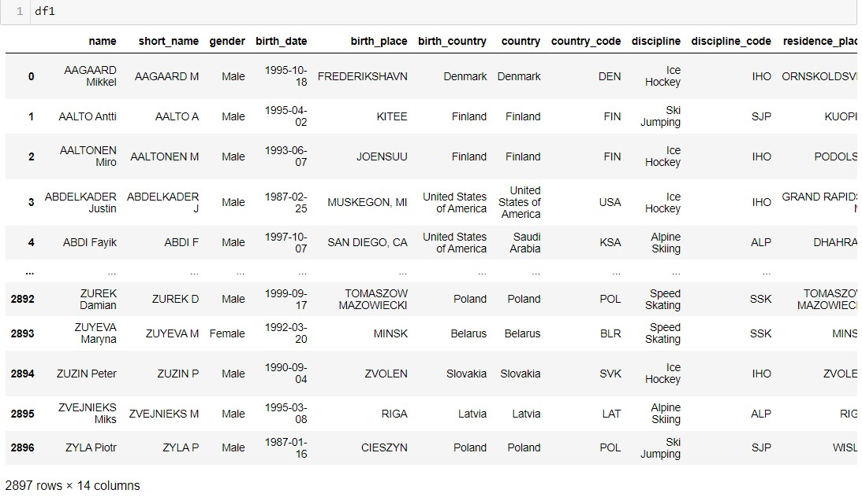
Project description
We created a table depicting the medals in SQL Database.

Slide 8
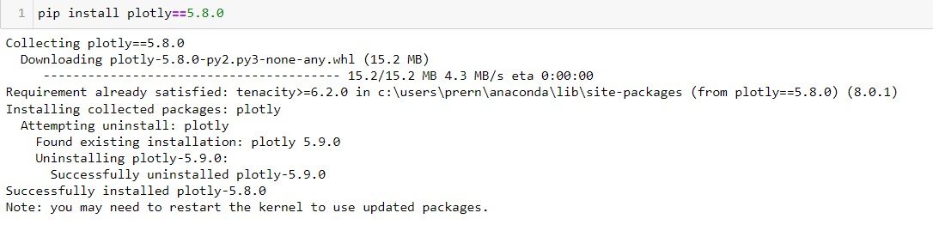
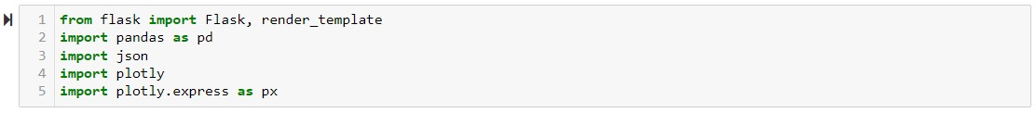
Project description
Then Plotly was used to construct graphs in Jupyter notebooks.
The flask framework was used to create a web application.

Slide 9
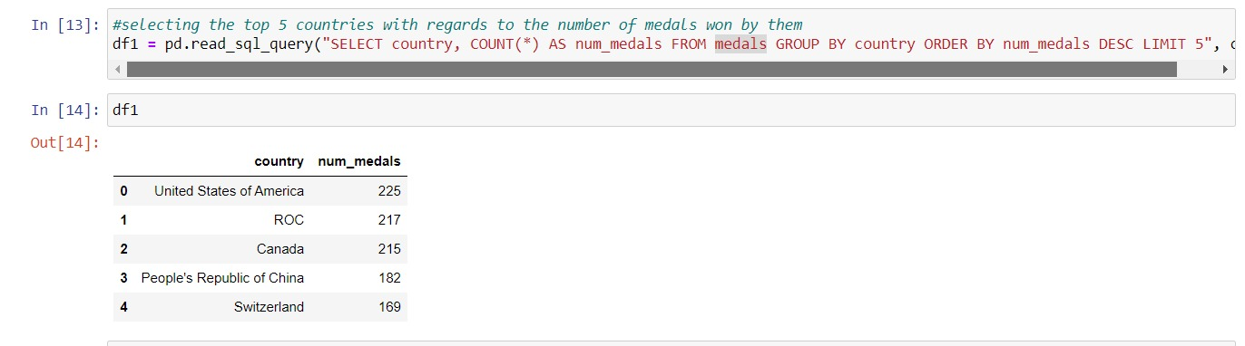
The project
Python codes to analyse and filter the data to get insights about the dataset.

Slide 10
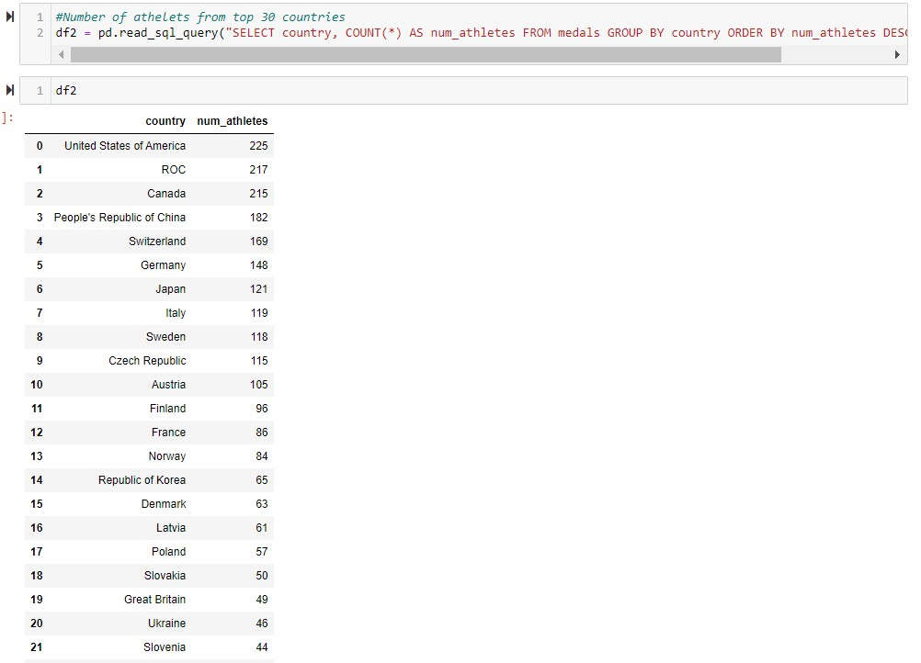
Number of athletes from top 30 countries

Slide 11
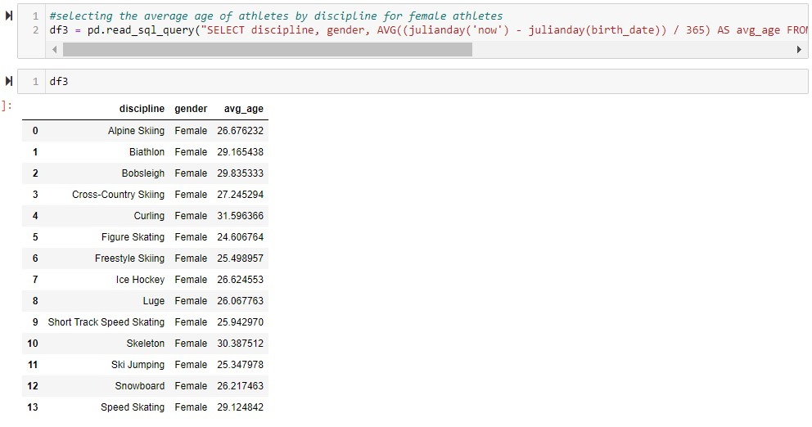
Average age of athletes by discipline for female athletes

Slide 12
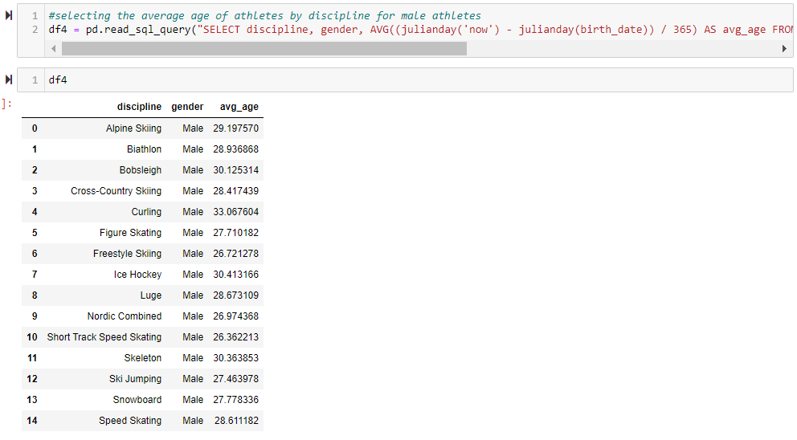
Average age of athletes by discipline for male athletes

Slide 13
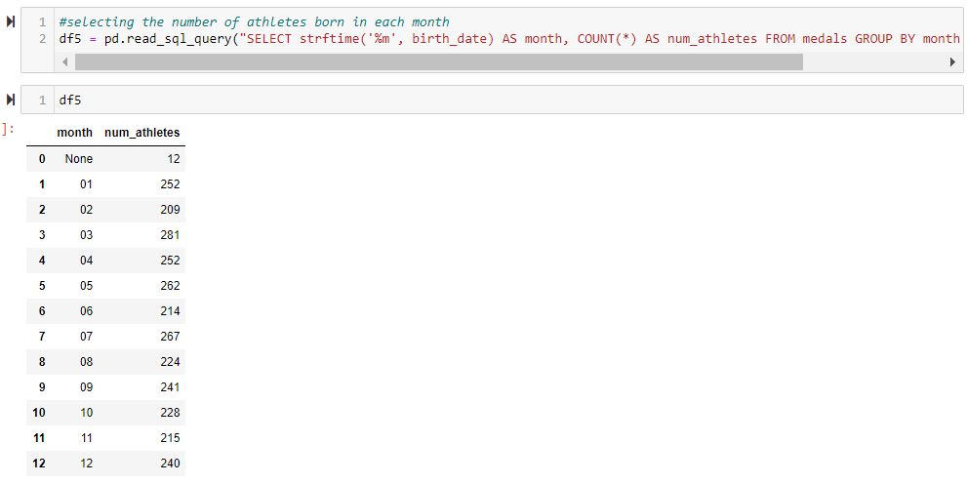
Number of athletes born in each month

Slide 14
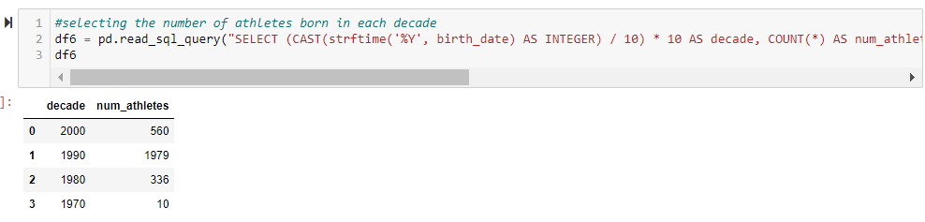
Number of athletes born in each decade

Slide 15
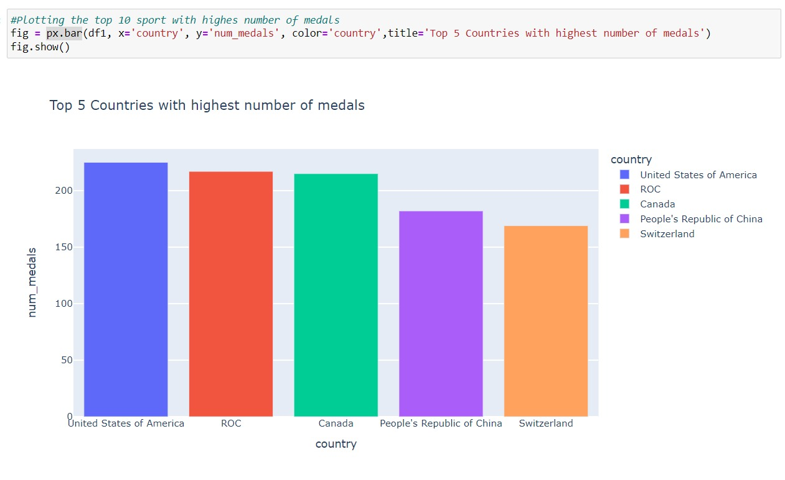
Output charts

Slide 16
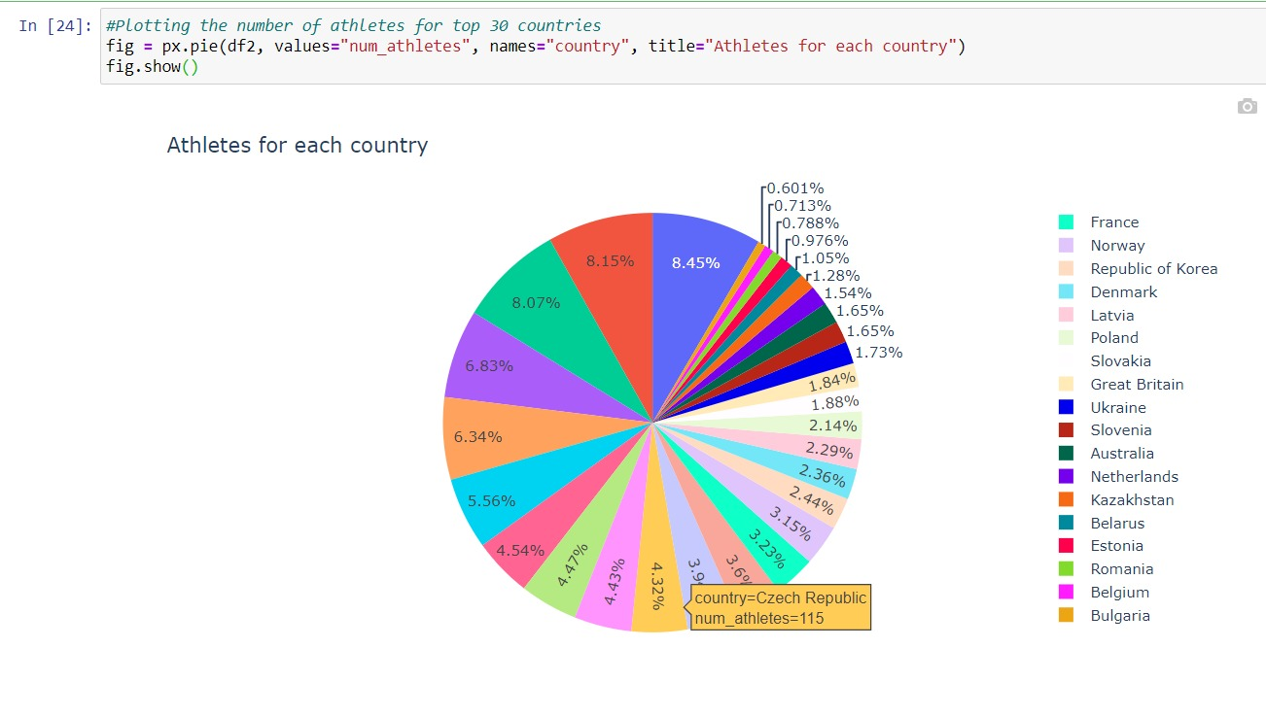
Number of athletes for top 30 coutries

Slide 17
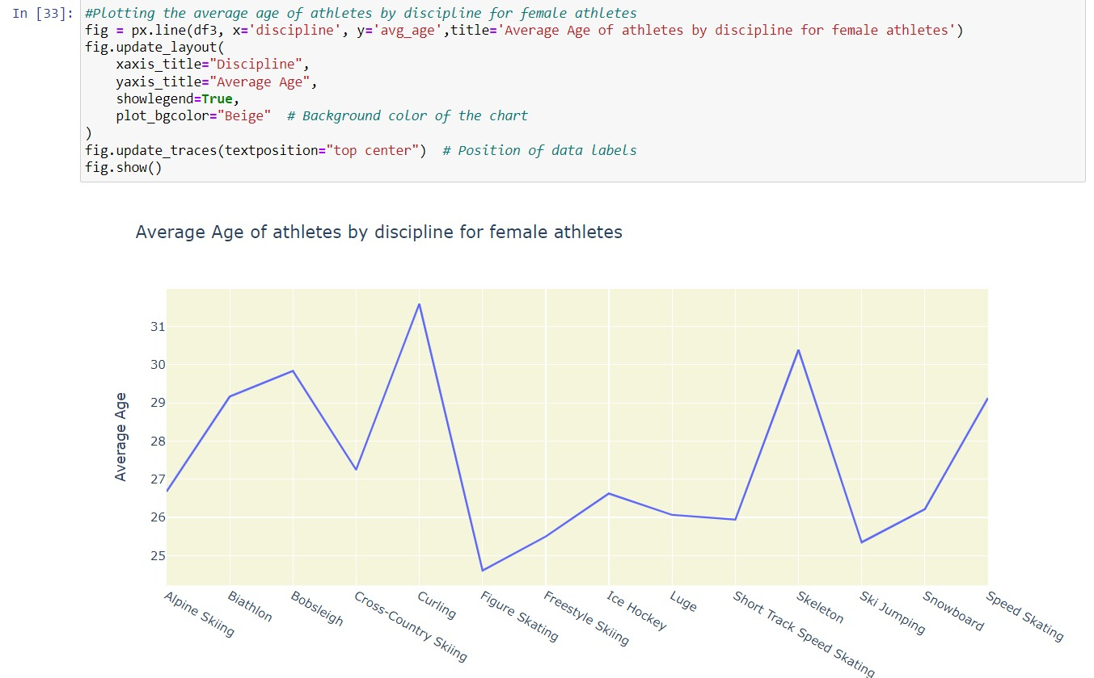
Average age of athletes by discipline for female athletes

Slide 18
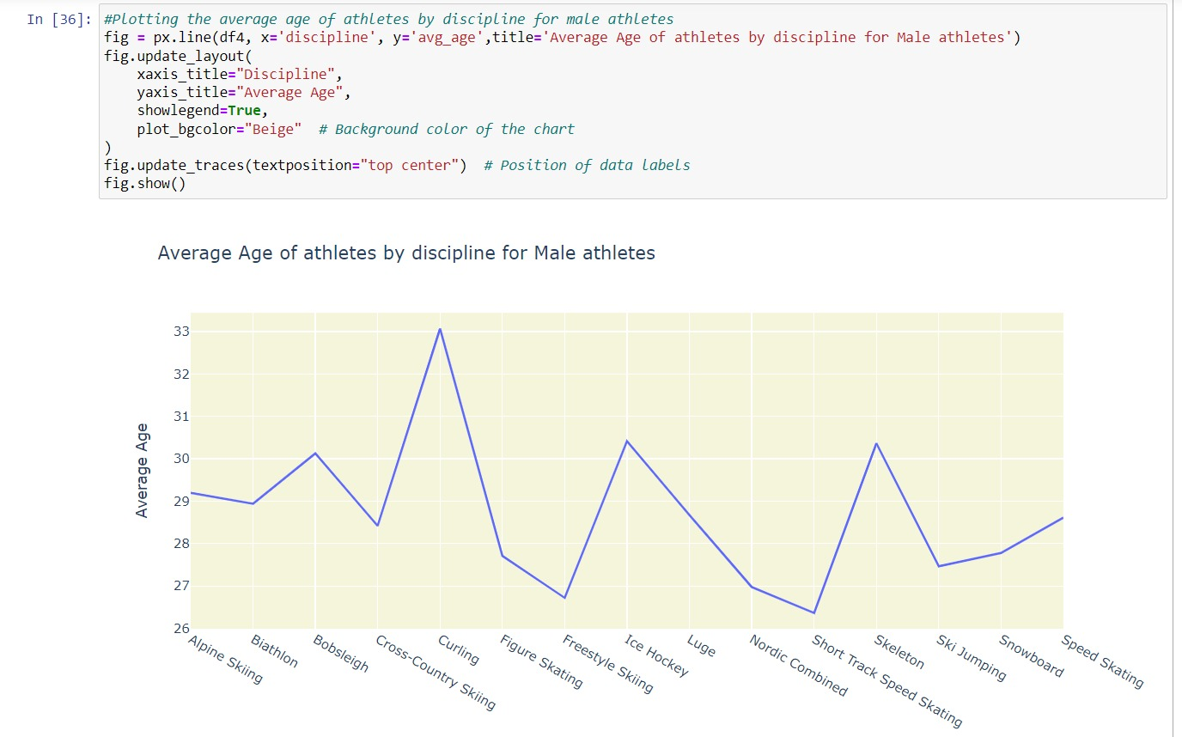
Average age of athletes by discipline for male athletes

Slide 19
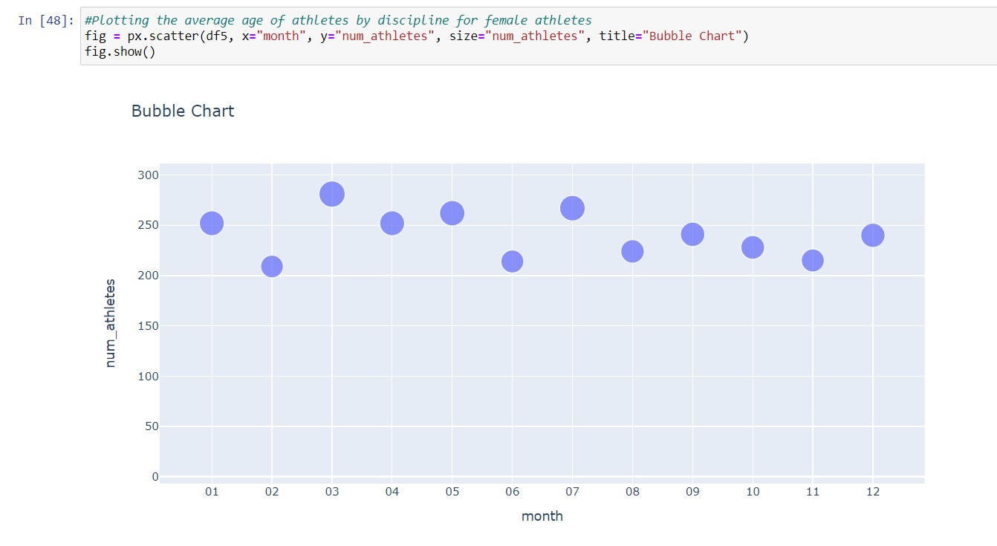
Number of athletes born in each month

Slide 20
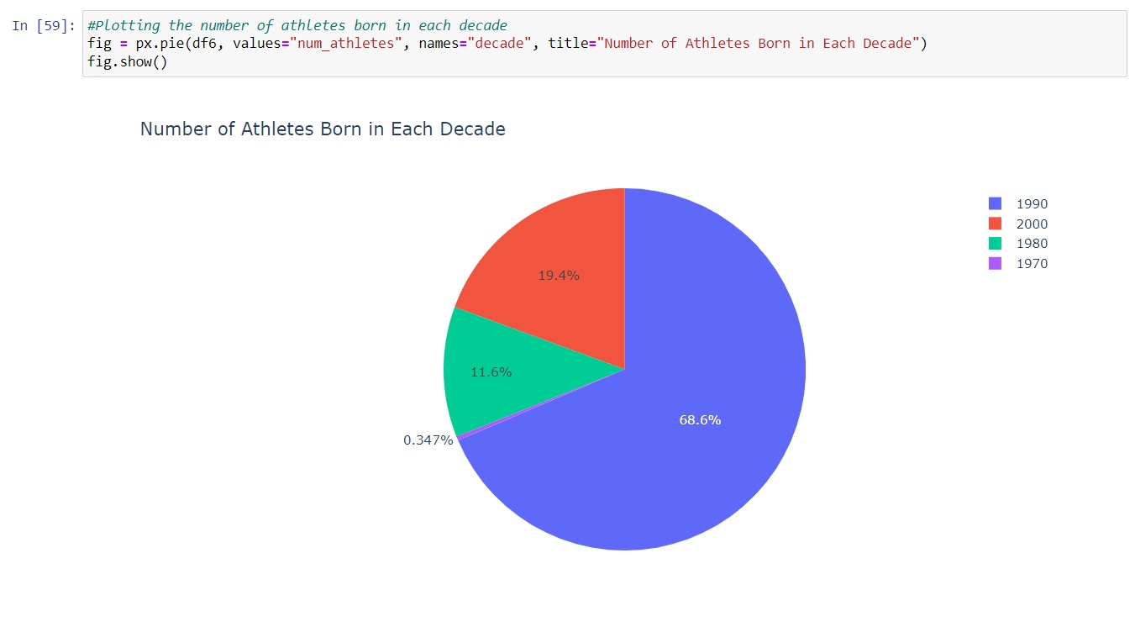
Number of athletes born in each decade

Slide 21
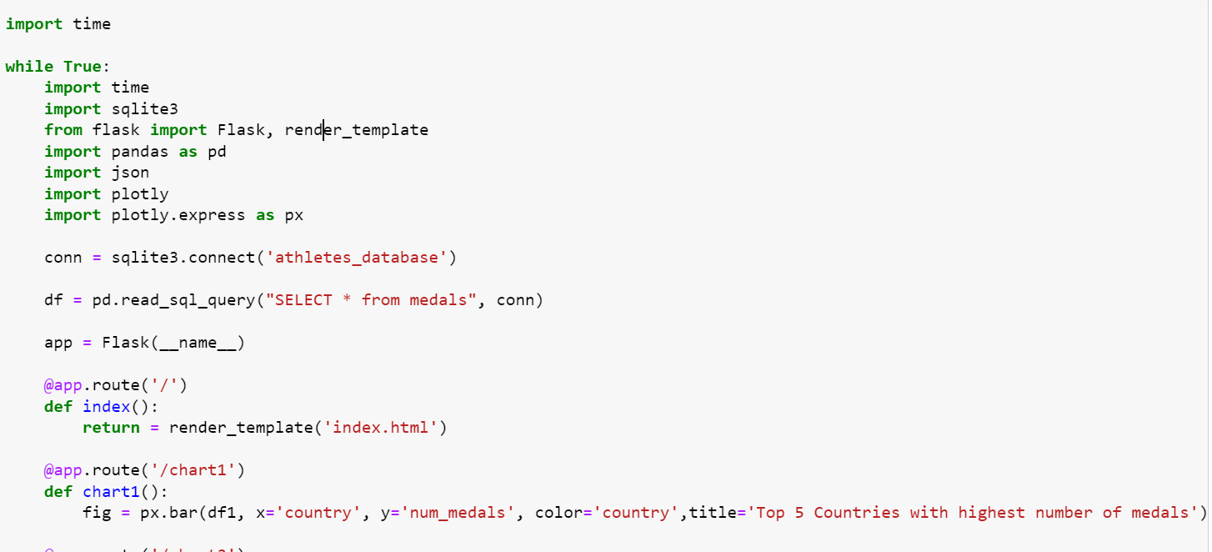
Using Flask

Slide 22
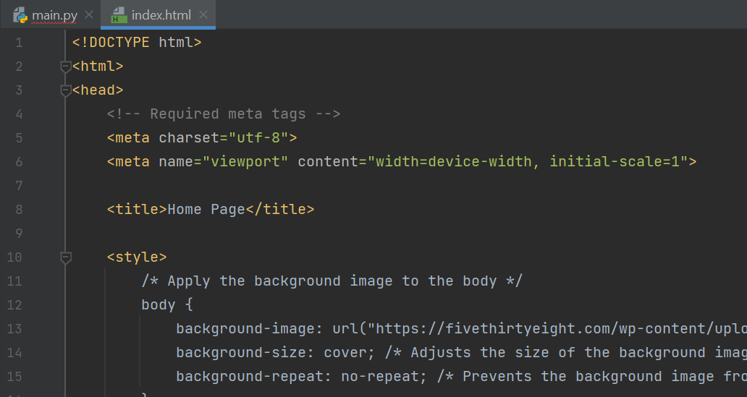
INDEX.HTML

Slide 23
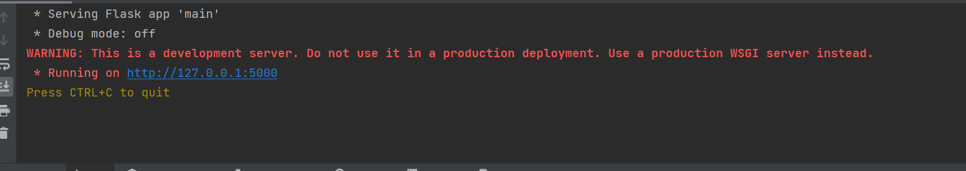
Output

Slide 24
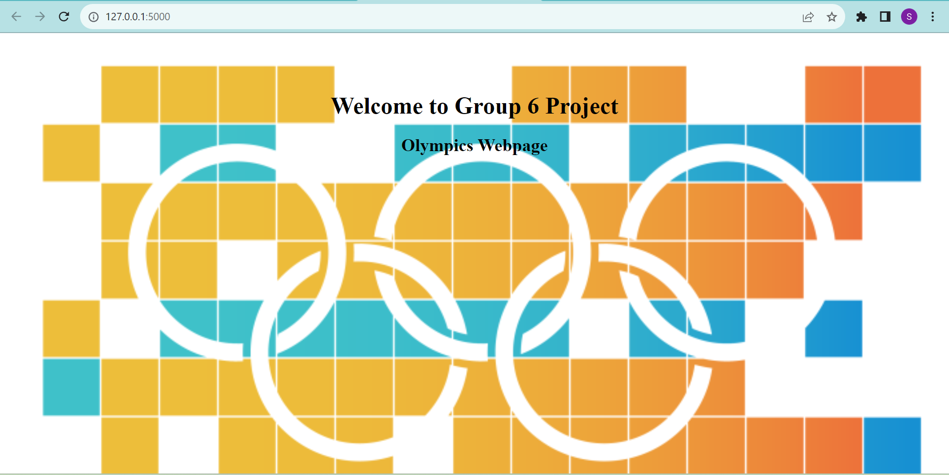
Using Flask
Created Home Page

Slide 25
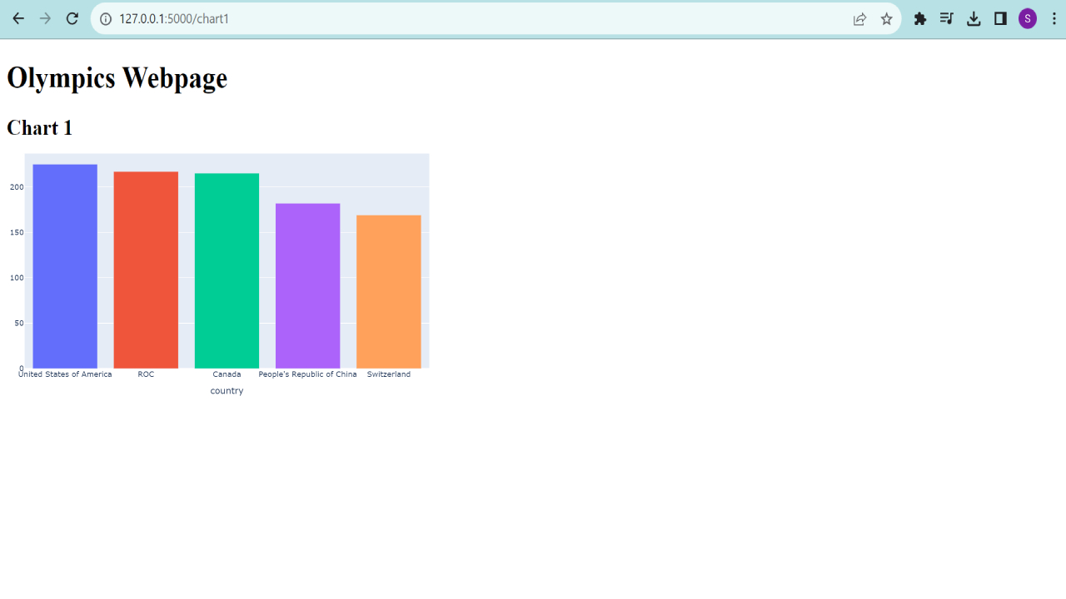
Using Flask
Created Display Page

Slide 26
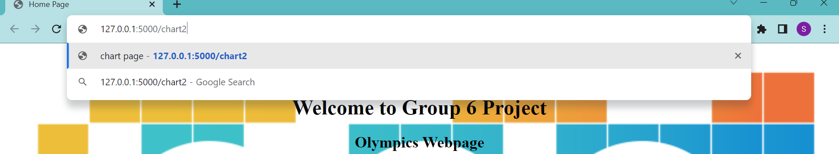
Using Flask
Created Display Page

Slide 27
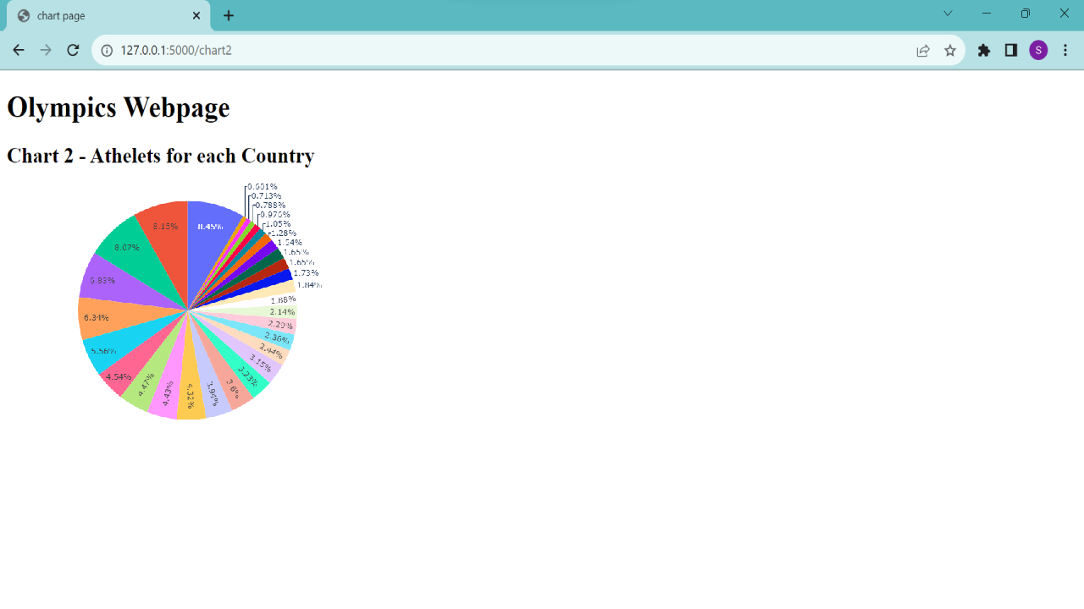

Slide 28
Project description
An API was created for this dataset, that automatically runs and updates new data to visually represent the charts, every 24 hours.
GITHUB repository can also be found attached below: https://github.com/SrishtiSeth1998/Group6BDAT_finalproject

